Slide 1


FSDL Jury Examination
Student Name : Prathmesh Waghmare Enrollment No. : ADT23SOCBD1545
Course : FSDL( 23IT3001 )
Semester : V
Class : TY IT SMAD
Department of Information Technology MIT School of Computing , Pune
A.Y. 2025-26

Slide 2
Problem Scope and Objectives
People love gaming but often struggle to find and buy games easily because stores are confusing or scattered. GameHub provides a simple and clean platform where users can explore games, add them to a cart, and check out smoothly — making game shopping quick and enjoyable.
Browse and Discover Games:
Add to Cart & Manage Items:
Secure Login & Checkout:
Allow users to view and explore a wide range of games with clean visuals and easy navigation.
Enable users to add games to the cart, update quantities, and remove items for a smooth shopping experience.
Provide a simple login and signup system, ensuring only verified users can access the checkout page.

Slide 3
Technology Stack
React JS
Used as the main JavaScript library for building the user interface and interactive components of the web application.
VS-Code
Code editor used for development, testing, and debugging the React application.
JSX
Defines the UI structure and styling of components, enabling a modern and responsive interface.
React Router
Manages navigation between pages (Home, Games, Cart, Login, Checkout) and protects routes like checkout.

Slide 4
Technology Stack
05
Add to Cart Button
Provides quick access to add selected games to the shopping cart instantly.
Local Storage
Used for storing user login details and cart data locally, ensuring session persistence across app usage.
Tailwind CSS
Ensures a modern, responsive, and user-friendly interface with clean design and smooth styling.
Protected Routing
Controls access to restricted pages like Checkout, ensuring only logged-in users can proceed.

Slide 5
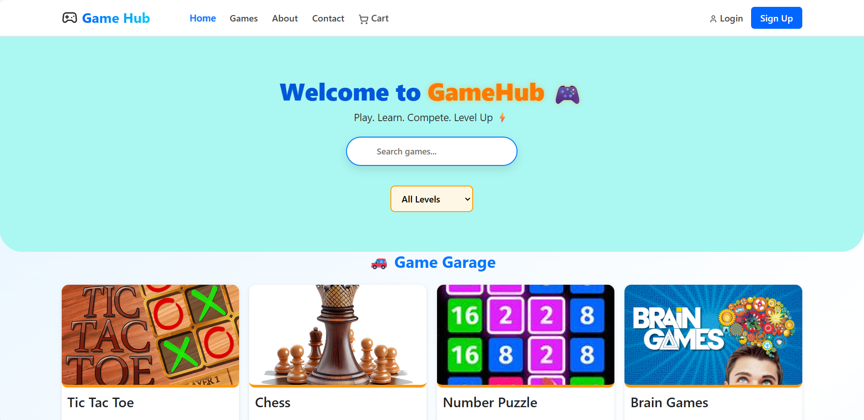
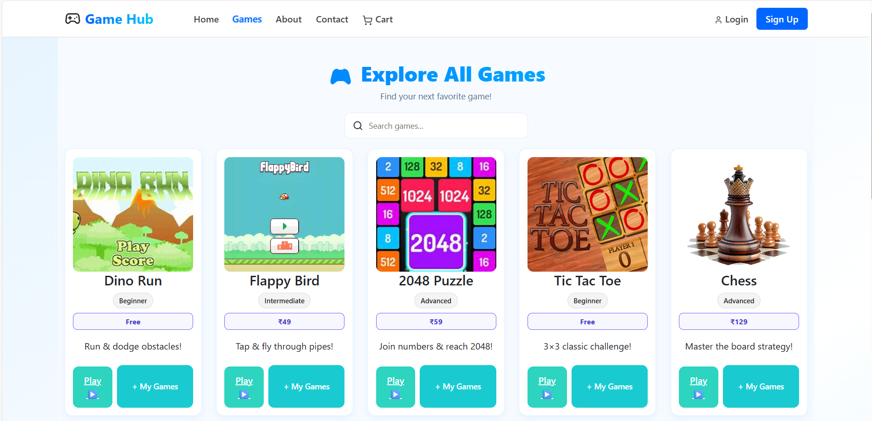
Implementation
Frontend

Slide 6
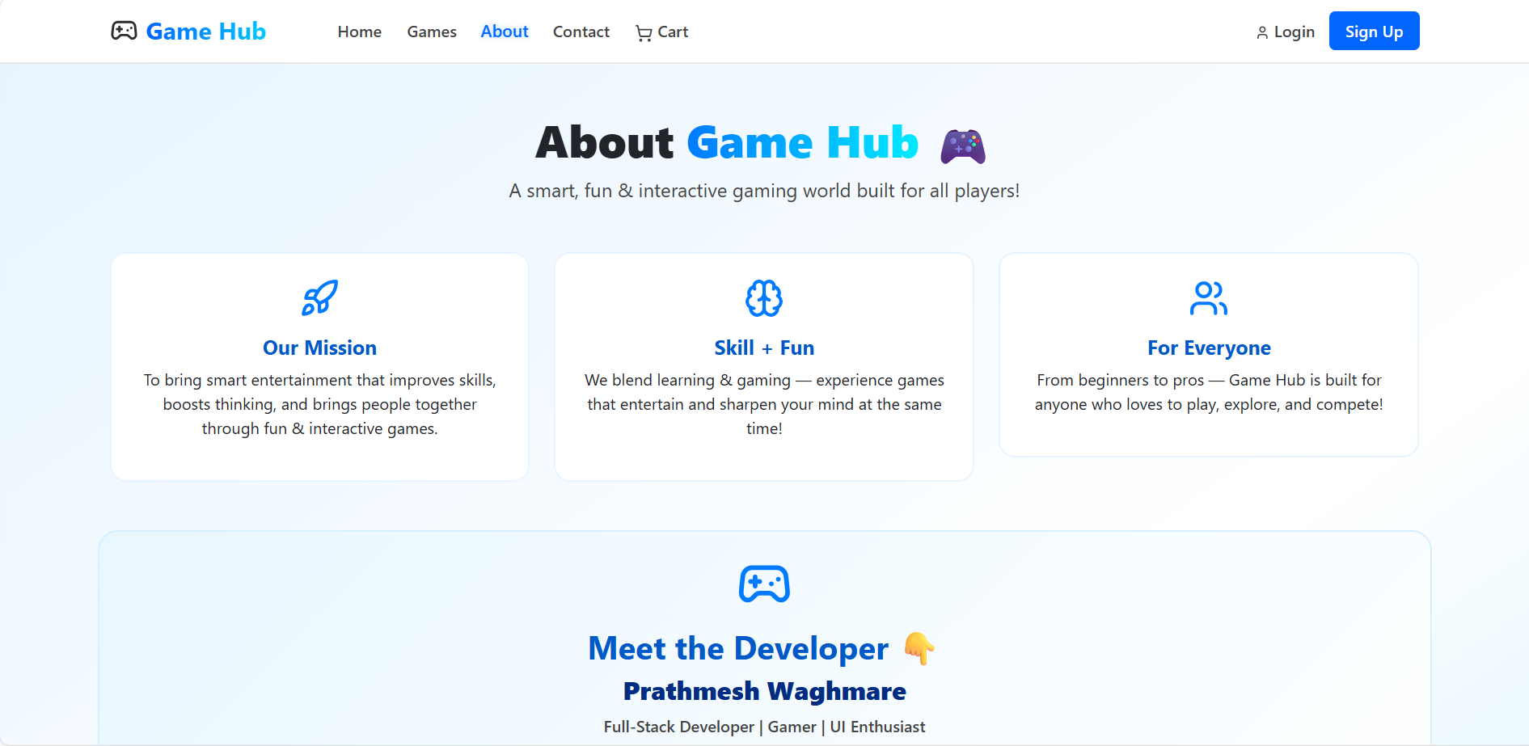
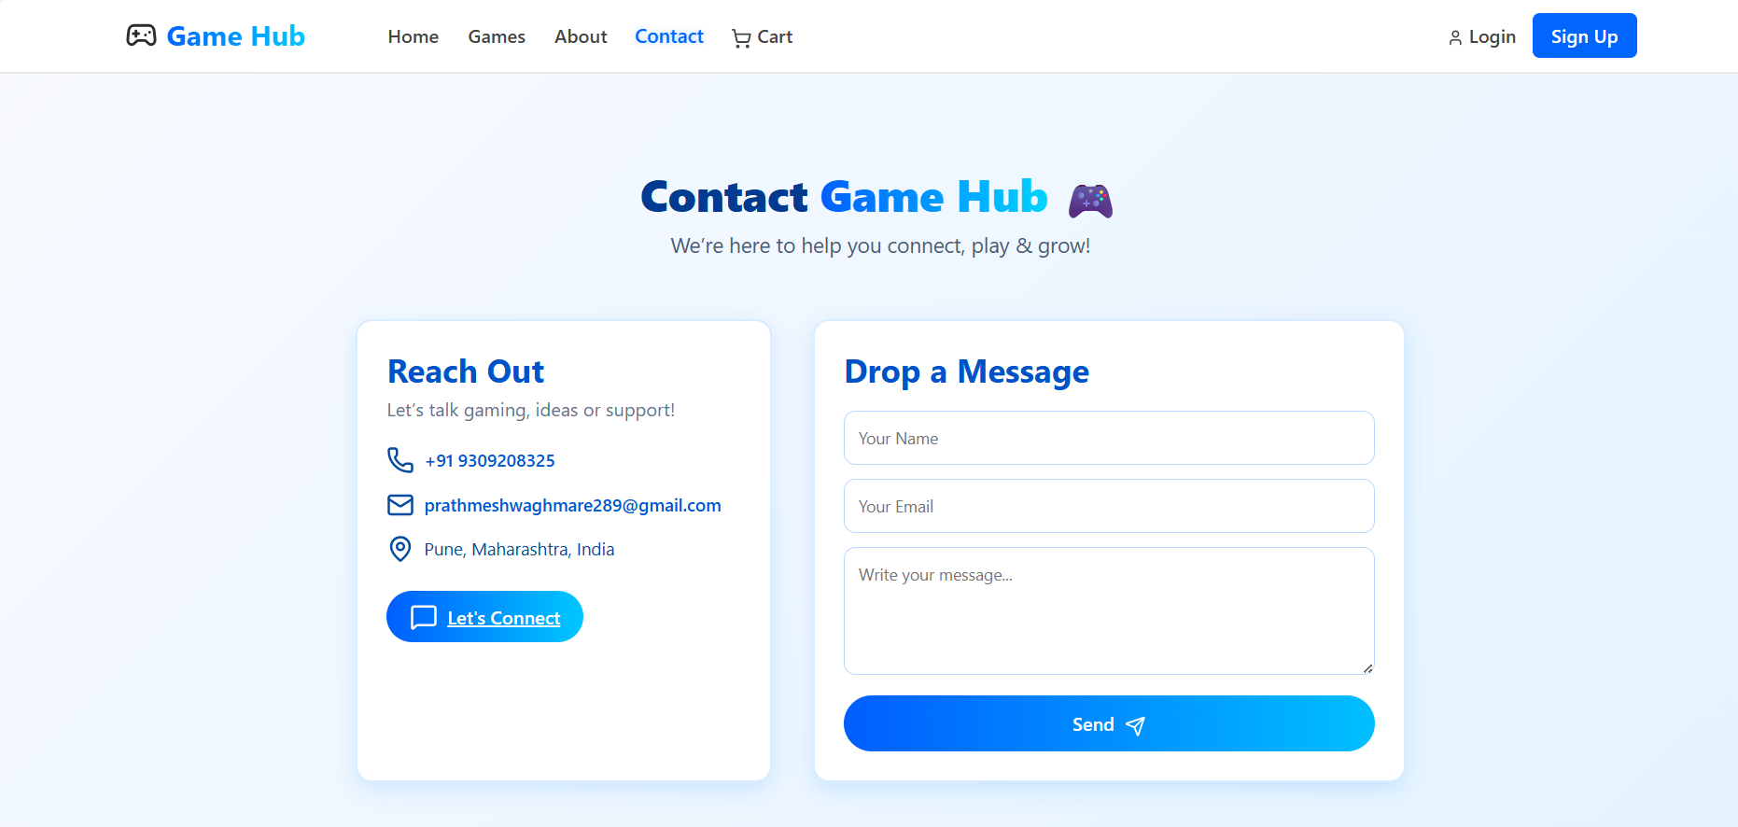
Implementation
Frontend

Slide 7
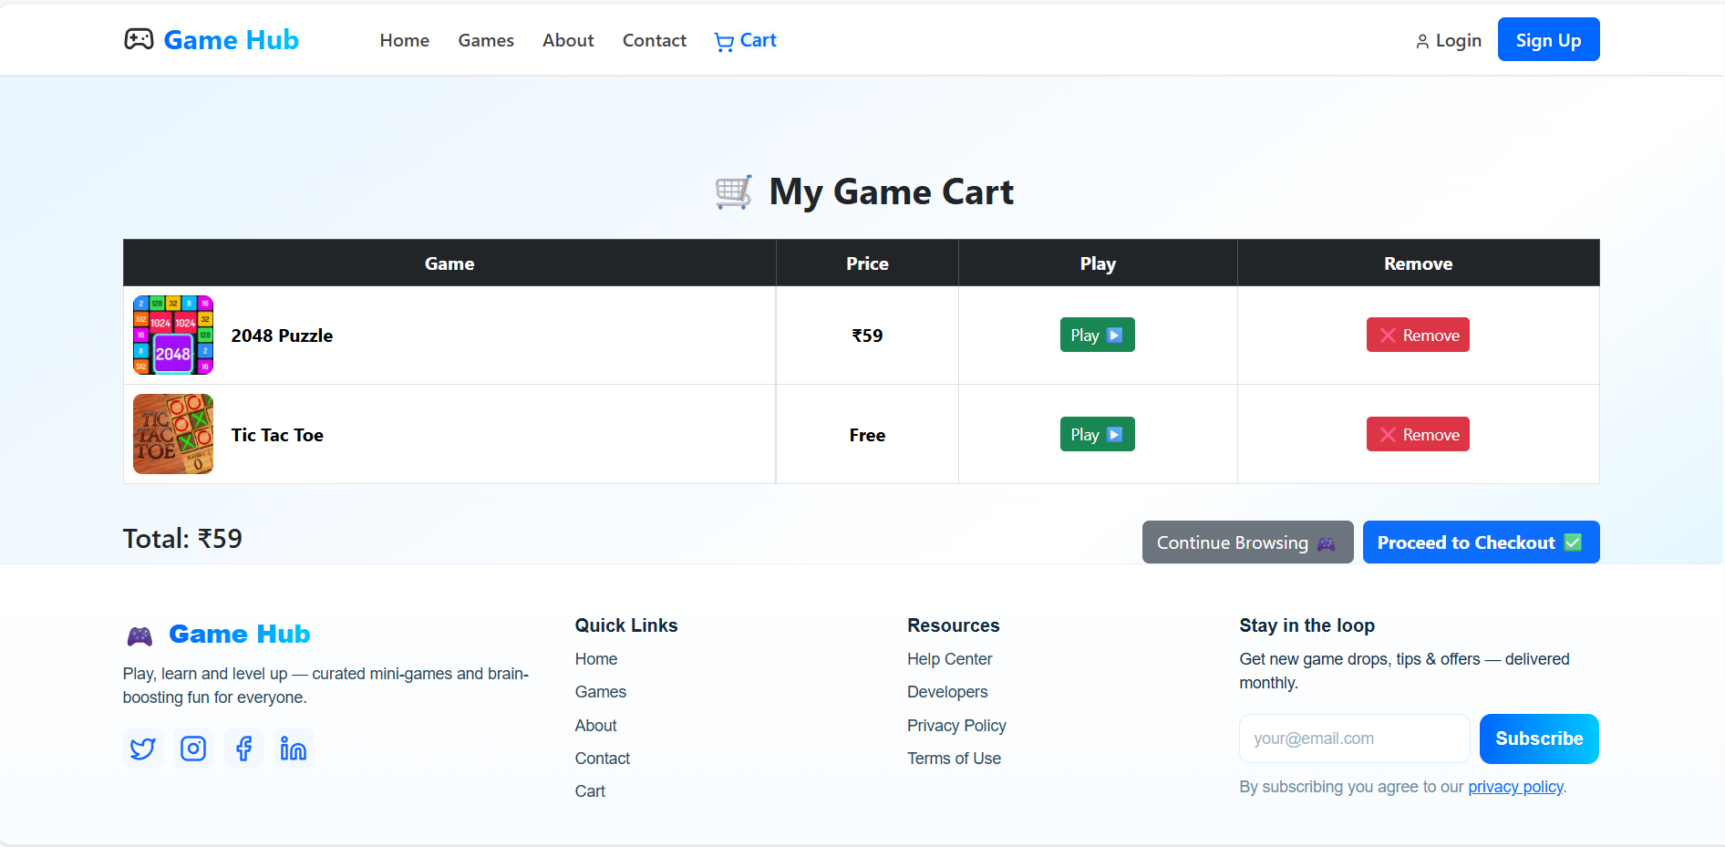
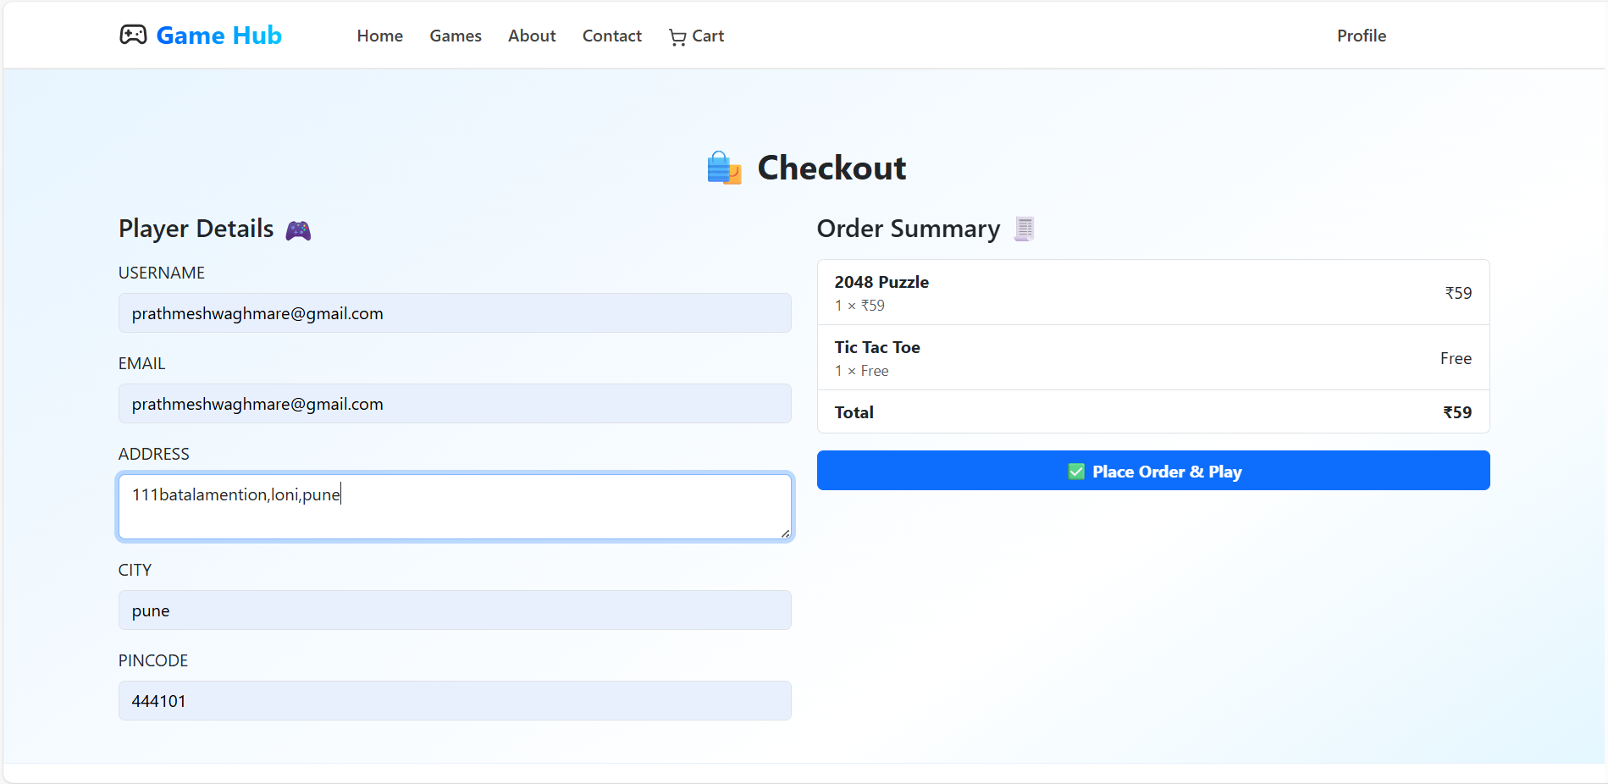
Implementation
Frontend

Slide 8
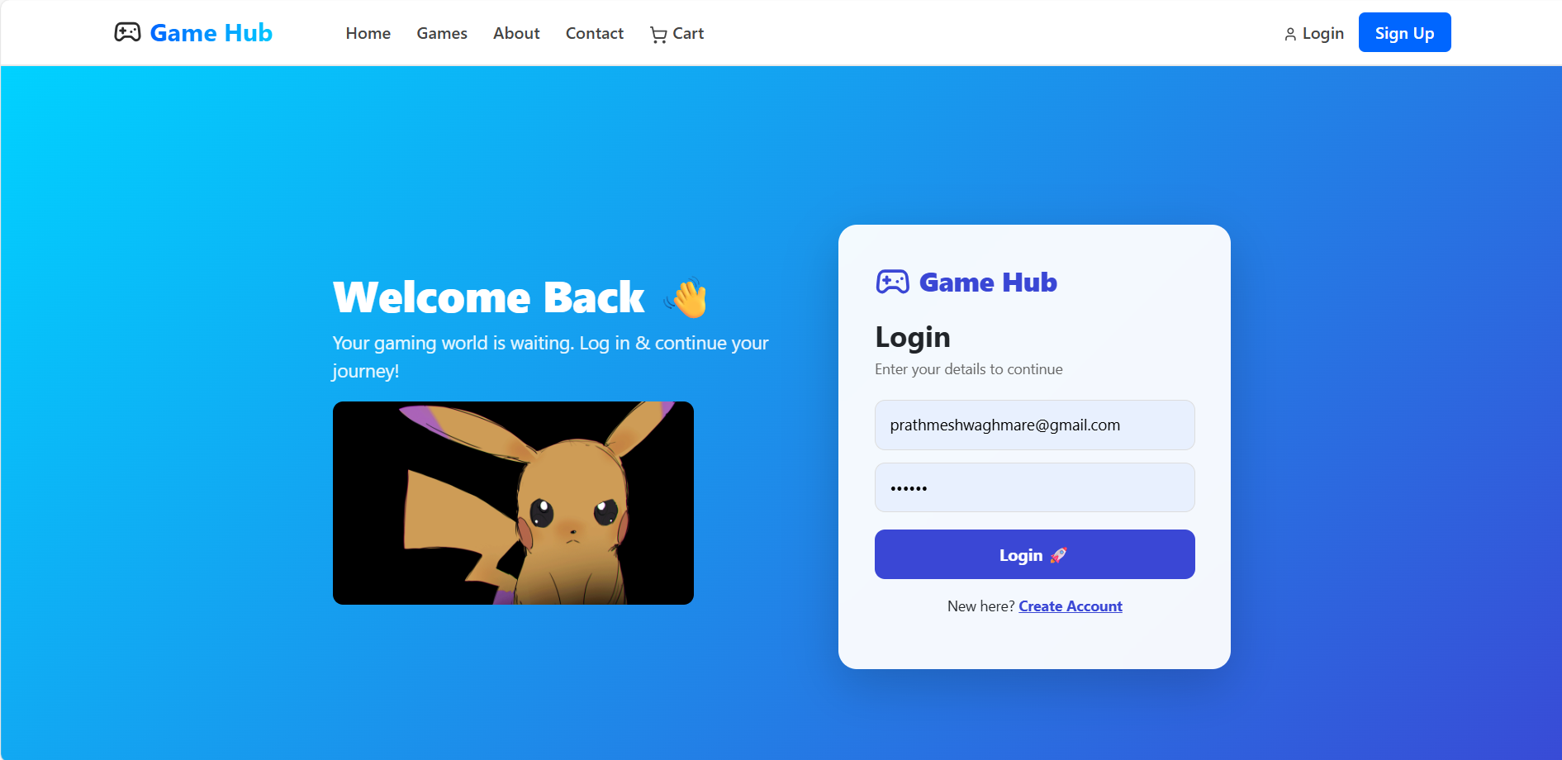
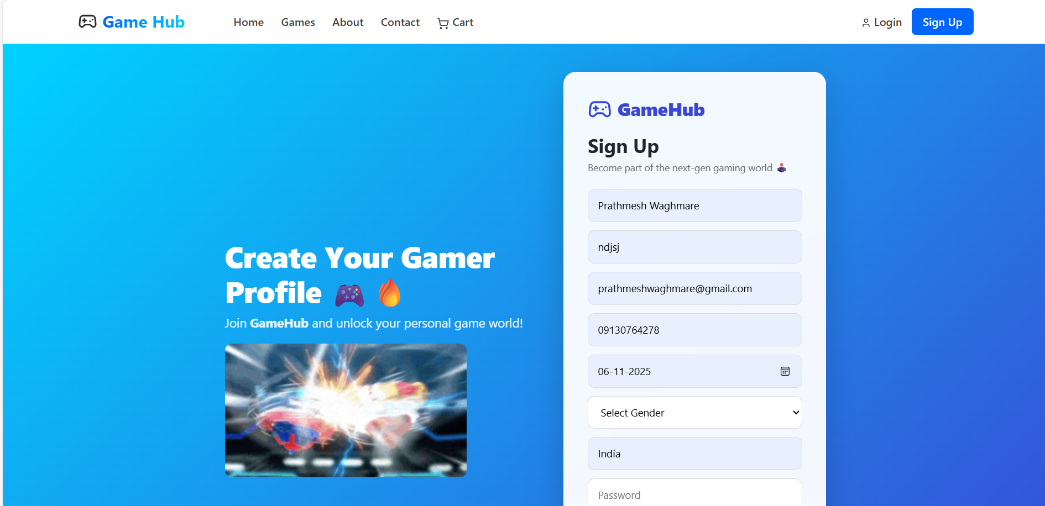
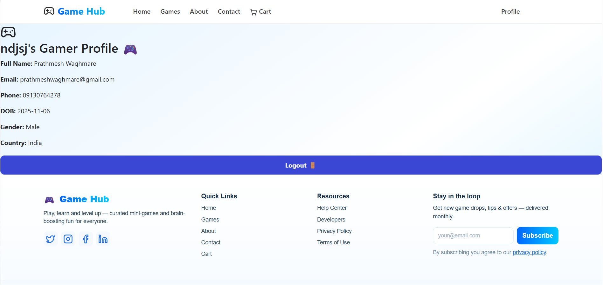
Implementation
Frontend

Slide 9
Conclusion & Future Scope
GameHub is a simple and easy-to-use platform where users can browse games, add them to a cart, and check out smoothly. The project focuses on giving a clean and friendly experience, showing how React can be used to build a real online store. It works fast, looks modern, and makes game shopping feel effortless.
In the future, I plan to add more features like real payments, a proper database, and user accounts. I also want to include things like wishlists, game reviews, and cloud data, so users can enjoy a complete and professional gaming store experience.

